Slide 1
Hashing

Slide 2
Try to implement the following Abstract Data Type using a Data Structure which makes each operation cost O(log n) in the average case.
Challenge: O(1) in the average case.
Dictionary {”Hanzhi": "lecturer", ”Tracy": "tutor", ”Shaanan": "coordinator"}
(key, value)
add(key, value) - add a value with key to the dictionary (d[key] = value)
get(key) - get the value stored with key (d[key])
remove(key) - delete a key value pair (del d[key])
array -- O(n) add (linear search), O(n) remove, O(n) contains (linear search)
sorted array -- O(n) add (insertionsort), O(n) remove, O(log n) contains (binary search)
linked list -- O(n) add (linear search), O(n) remove, O(n) contains (linear search)
balanced BST O(log n) for everything! -sort by key
Hash Table -- O(1) for everything!

Slide 3
Dictionaries (ADT)
{
"Pride and Prejudice": "Alice",
"Wuthering Heights": "Alice",
"Great Expectations": "John"
}
create_new()
insert(D, key, item) ( want O(1) )
item <- search(D, key) ( want O(1) )
delete(D, key) ( want O(1) )
free()

Slide 4
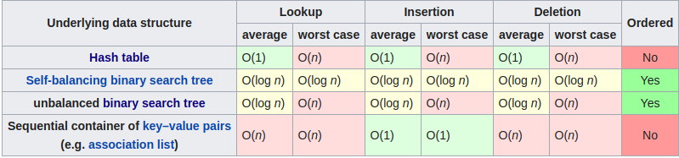
Dictionaries (ADT)
{
"Pride and Prejudice": "Alice",
"Wuthering Heights": "Alice",
"Great Expectations": "John"
}
create_new()
insert(D, key, item) ( want O(1) )
item <- search(D, key) ( want O(1) )
delete(D, key) ( want O(1) )

Slide 5
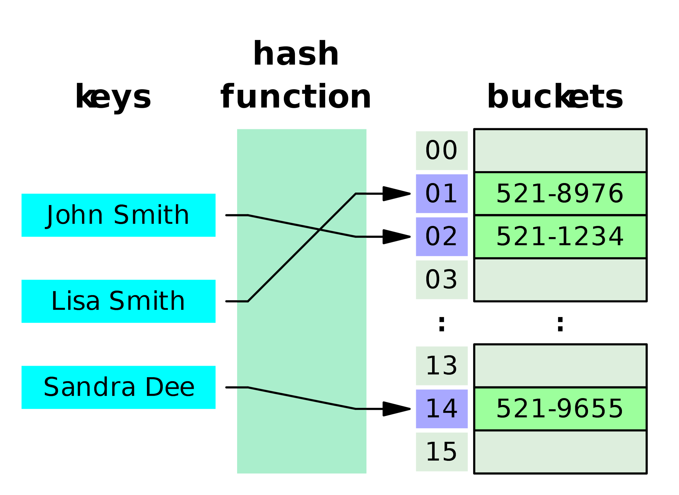
Hash tables / hash map
Maps keys to values. (think python dictionary)
Use a hash function to compute an index into an array of buckets
Ideally: each key is assigned into a unique bucket (perfect hash function)
We have collisions: hash function generates same index for >1 key.
There are ways to solve this!
 | Average | Worst case
Insert | O(1) | O(n)
Search | O(1) | O(n)
Delete | O(1) | O(n)

Slide 6
Hash tables Issues
collisions
hash function generates same index for multiple keys
can't store that element!
resizing
run out of space in hashmap! => need to rehash everything => O(n)
h(x) = x%50
h(13) = 13
h(3) = 3
h(23) = 23
 | Average | Worst case
Insert | O(1) | O(n)
Search | O(1) | O(n)
Delete | O(1) | O(n)

Slide 7
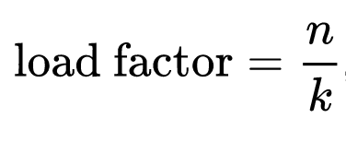
Load factor
n is the number of entries occupied in the hash table
k is the number of buckets
Higher load factor: greater chance of collision! (more buckets are full)
Lower load factor: wasted memory, and not necessarily any reduction in search cost
Java: aims for load factor of 0.75.
If the HashMap’s load reaches 0.75, we resize the hashmap.
Resizing: double array size, need rehash all values => O(n) … bad!

Slide 8
Collision resolution
The way we handle collisions will erode the performance of the hash table. We lose O(1)!
Separate chaining
Cuckoo hashing
Linear probing
To consider: do we maintain O(1) insert/delete/search with these schemes?

Slide 9
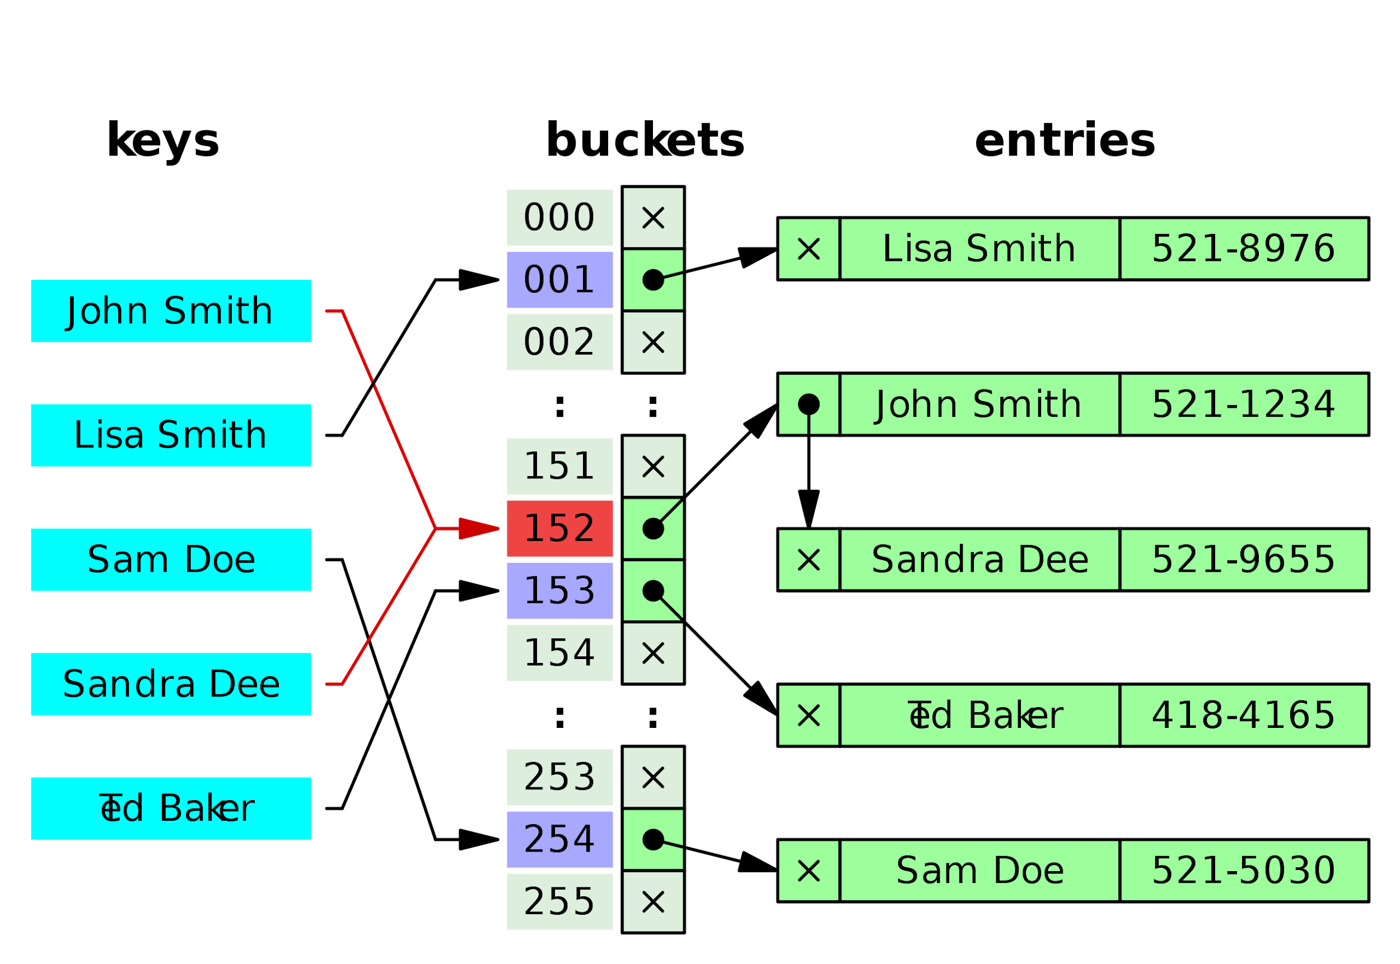
Separate chaining
Instead of having buckets of values, have buckets of some secondary data structure. (eg: linked list, array, another hashmap => all different properties)
Each bucket has a list of entries with the same index.
O(1) to find the correct bucket, then O(m) to search through the bucket:
Searching through linked list: O(n)
Balanced binary tree: O(log n)
HashMap Java 8

Slide 10
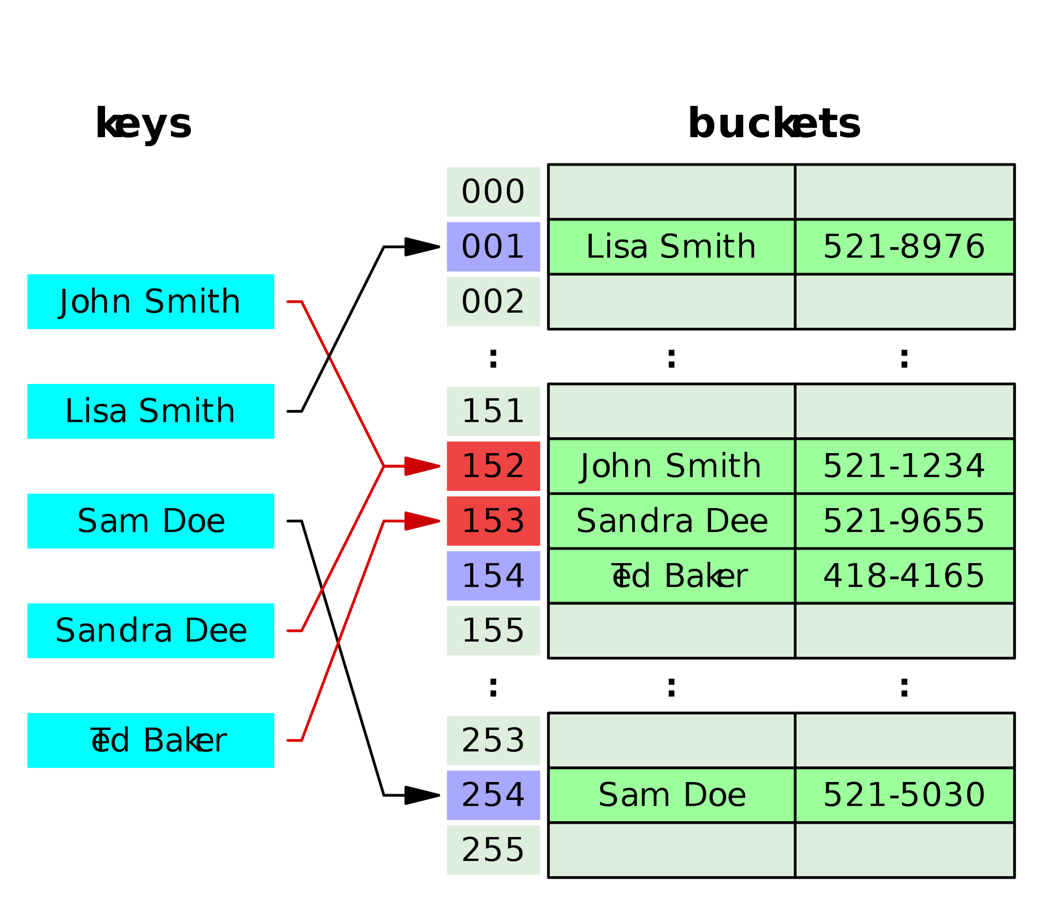
Linear Probing
Buckets are values as usual.
If there is a collision, we search linearly forward until an unoccupied slot is found. (eg: idx 100 full? go to 101. or 102. or 103…)
Time complexity: O(n) still, just resolves the collision part.
How to delete elements? O(n) search. -- bad!

Slide 11
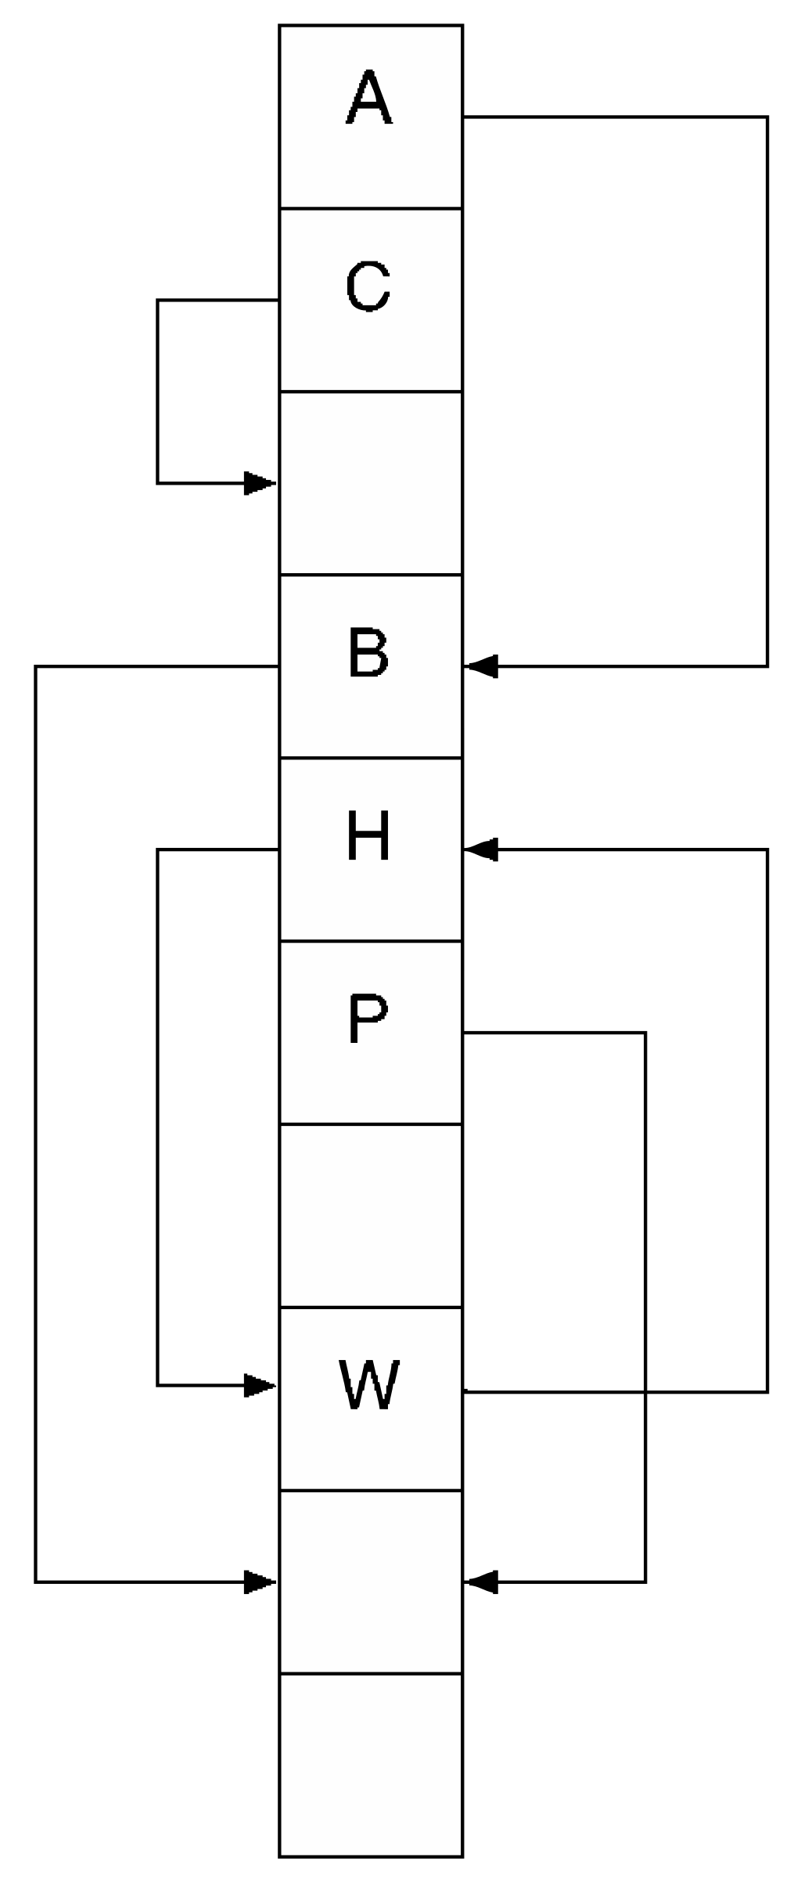
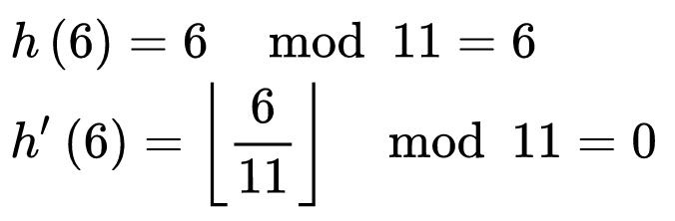
Cuckoo hashing
Use multiple hash functions.
Lookup: use hash function 1
If not found, use hash function 2
Etc
Insertion: use hash function 1.
If collision, use hash function 2
Etc
Deletion, same as lookup.
Worst case: O(1)
Careful with cycles!

Slide 12
Cuckoo hashing - more details
on collision: displace the previous object to allow the new one to be in its right spot, then re-insert it using a different hash function
Use multiple hash functions.
Lookup: use hash function 1
If not found, use hash function 2.
Insertion: use hash function 1.
If collision, use hash function 2
Deletion, same as lookup.
Worst case: O(1)
Efficient; but careful with cycles!

Slide 13
Issues with hashing
Collisions!
The way we handle collisions will erode the performance of the hash table. Loses O(1)!
Want to avoid collisions.
If the hash table is nearly full -> more likely to have a collision!
If array is full -> guaranteed for collision!
If the hash table is nearly empty -> wasting space!
Similar to having an array of size 1000. We want to start small and grow.
Solution:
If hash table is at 75% capacity - resize it.
How to resize? Double the size of the array, AND need to rehash every element. Time?

Slide 14
Hash tables / hash map
Maps keys to values. (think python dictionary)
in memory, same as an array ("associative array")
Use a hash function to compute an index into an array of buckets
Ideally: each key is assigned into a unique bucket (perfect hash function)
eg: hash ints: h(x) = x % 10 (set N_BUCKETS = k = 10)
% modulo (remainder)
Insert into hash table: 2, 7, 85, 8, 28, 6.
13 / 10 = remainder? 3
k=10 n=0
k: # buckets, n: # elements in map
H
 |  | 2 | 13 |  | 85 |  | 7 | 8 |28
idx
0 | 1 | 2 | 3 | 4 | 5 | 6 | 7 | 8 | 9

Slide 15
Hash tables / hash map
Use a hash function to compute an index into an array of buckets
Ideally: each key is assigned into a unique bucket (perfect hash function)
eg: hash ints: h(x) = x % N_BUCKETS (set N_BUCKETS = k = 10)
h1(x) = x % 10; k: # buckets; n = num elements
h2(x) = x % 20; chance of collision: 1/(k - n)
Insert into hash table: 2, 85, 8, 28, 6, 17. h(28) = 28 % 10 = 8
2 5 8 8 6 7 17
 |  | 2 |  |  | 85 | 6 |  | 8 28
 |  |  |  |  |  |  | 17
H
idx
0 | 1 | 2 | 3 | 4 | 5 | 6 | 7 | 8 | 9

